Slide 1
HIERARCHICAL MODEL
Data model in which Data is represented in the tree-like structure.
Data is stored in the form of records which are the collection of fields.
The records are connected through links and the type of record tells which field is contained by the record.
Each field can contain only one value.
It must have only one parent for each child node but parent nodes can have more than one child.

Slide 2
HIERARCHICAL MODEL
Multiple parents are not allowed.
This is the major difference between the hierarchical and network Database model.
The first node of the tree is called the root node.
When Data needs to be retrieved then the whole tree is traversed starting from the root node.
This model represents one- to- many relationships.

Slide 3
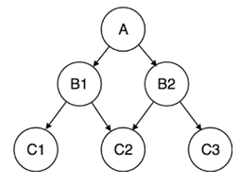
example

Slide 4
Advantages
Data can be retrieved easily due to the explicit links present between the table structures.
Referential integrity is always maintained i.e. any changes made in the parent table are automatically updated in a child table.
Promotes data sharing.
It is conceptually simple due to the parent-child relationship.
Database security is enforced.
Efficient with 1: N relationships.
A clear chain of command or authority.
Increases specialization.
High performance.
Clear results.

Slide 5
Disadvantages
Below are some of the disadvantages given.
If the parent table and child table are unrelated then adding a new entry in the child table is difficult because additional entry must be added in the parent table.
Complex relationships are not supported.
Redundancy which results in inaccurate information.
Change in structure leads to change in all application programs.

Slide 6
Disadvantages
M: N relationship is not supported.
No data manipulation or data definition language.
Lack of standards.
Poor flexibility
Communication barriers
Organizational Disunity.
Rigid structure

Slide 7
Features
Some features are pointed out below:
Many to many relationships: It only supports one – to – many relationships. Many to many relationships are not supported.
Problem in Deletion: If a parent is deleted then the child automatically gets deleted.
Hierarchy of data: Data is represented in a hierarchical tree-like structure.
Parent-child relationship: Each child can have only one parent but a parent can have more than one children.

Slide 8
Features
Pointer: Pointers are used for linking records that tell which is a parent and which child record is.
Disk input and output is minimized: Parent and child records are placed or stored close to each other on the storage device which minimizes the hard disk input and output.
Fast navigation: As parent and child are stored close to each other so access time is reduced and navigation becomes faster.
Predefined relationship: All relations between root, parent and child nodes are predefined in the database schema.
Re-organization difficulty: Hierarchy prevents the re-organization of data.
Redundancy: One to many relationships increases redundancy in the data which leads to the retrieval of inaccurate data.

Slide 9
Example
Let us take an example of college students who take different courses. A course can be assigned to an only single student but a student can take as many courses as they want therefore following one to many relationships.

Slide 10
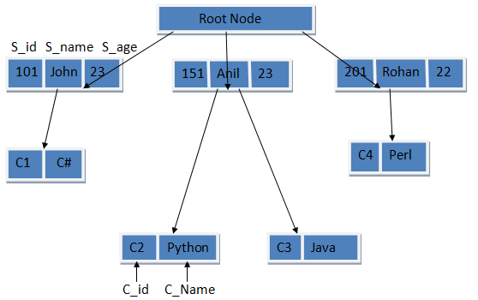
example

Slide 11
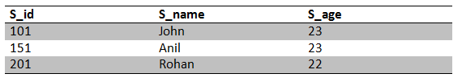
Student Table:

Slide 12
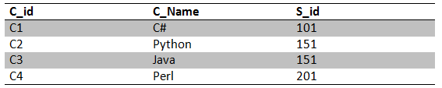
Course Table:

Slide 13
Conclusion
Depicts the parent-child relationship which makes it easy to represent data and understand the concept easily.
It was mostly used in times of mainframe computers but still, it is used in many fields where high performance and easy concepts are the parameters.
So the hierarchical model is efficient for one to many relationships and is widely used in recording file system data.

Slide 14
Network Model
The network database model was created to solve the shortcomings of the hierarchical database model.
In this type of model, a child can be linked to multiple parents, a feature that was not supported by the hierarchical data model.
The parent nodes are known as owners and the child nodes are called members.

Slide 15
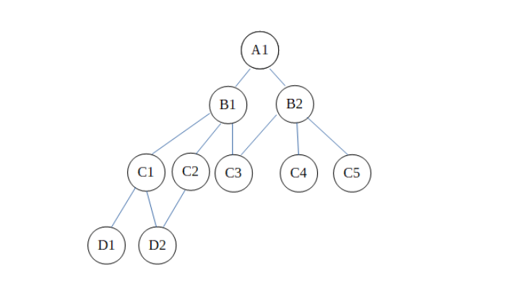
example

Slide 16
Advantages of Network Model
The network model can support many to many relationships as seen in the diagram.
D2 and C3 each have multiple masters.
The masters for D2 are C1 and C2 while for C3 are B1 and B2.
In this way, the network data model can handle many to many relationships where the hierarchical data model didn’t.

Slide 17
Disadvantages of Network Model
There are some disadvantages in the network model even though it is an improvement over the hierarchical model. These are −
The network model is much more complicated than the Hierarchical model. As such, it is difficult to to handle and maintain.
Although the Network model is more flexible than the Hierarchical model, it still has flexibility problems. Not all relations can handled by assigning them in the form of owners and members.
The structure of the Network Model is quite complicated and so the programmer has to understand it well in order to implement or modify it.

Slide 18
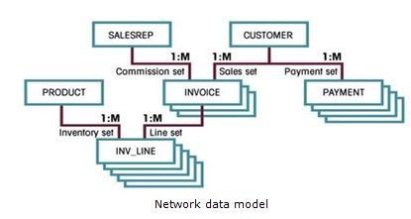

Slide 19
Functional Dependency
Functional Dependency (FD) determines the relation of one attribute to another attribute in a database management system (DBMS) system.
Functional dependency helps you to maintain the quality of data in the database.
A functional dependency is denoted by an arrow →.
The functional dependency of X on Y is represented by X → Y.

Slide 20
Types of Functional Dependencies
Multivalued dependency:
Trivial functional dependency:
Non-trivial functional dependency:
Transitive dependency:

Slide 21
Multivalued dependency in DBMS
Multivalued dependency occurs in the situation where there are multiple independent multivalued attributes in a single table.
Car_model | M_year | Color
H0012017MetallicH | 2017 | Green
H0052018Metallic | 2018 | Blue

Slide 22
In this example, maf_year and color are independent of each other but dependent on car_model. In this example, these two columns are said to be multivalue dependent on car_model.
This dependence can be represented like this:
car_model -> maf_year
car_model-> colour

Slide 23
Trivial Functional dependency:
The Trivial dependency is a set of attributes which are called a trivial if the set of attributes are included in that attribute.
So, X -> Y is a trivial functional dependency if Y is a subset of X.

Slide 24
For example:
Emp_id | Emp_name
AS555 | Harry
AS811 | George
AS999 | Kevin
Consider this table with two columns Emp_id and Emp_name.
{Emp_id, Emp_name} -> Emp_id is a trivial functional dependency as Emp_id is a subset of {Emp_id,Emp_name}.

Slide 25
Non trivial functional dependency in DBMS
Functional dependency which also known as a nontrivial dependency occurs when A->B holds true where B is not a subset of A. In a relationship, if attribute B is not a subset of attribute A, then it is considered as a non-trivial dependency.

Slide 26
Company | CEO | Age
Microsoft | Satya Nadella | 51
Google | sundar Pichai | 46
Example:
(Company} -> {CEO} (if we know the Company, we knows the CEO name)
But CEO is not a subset of Company, and hence it's non-trivial functional dependency.

Slide 27
Transitive dependency:
A transitive is a type of functional dependency which happens when t is indirectly formed by two functional dependencies.

Slide 28
NORMALIZATION
Normalization is a process of organizing the data in database to avoid data redundancy, insertion anomaly, update anomaly & deletion anomaly.

Slide 29
ANOMALIES
INSERT
DELETE
UPDATE
EMP ID | NAME | ADDRESS | DEPT
1 | RICK | AAA | CSE
1 | RICK | AAA | IT
2 | JAMES | BBB | ECE

Slide 30
NORMAL FORMS
First normal form(1NF)
Second normal form(2NF)
Third normal form(3NF)
Boyce & Codd normal form (BCNF)

Slide 31
FIRST NORMAL FORM
MUST HAVE ATOMIC VALUES
EMP ID | EMP NAME | ADDRESS | PHONE NUM
1 | JUDE | AAA | 94442121,3123132
2 | JOSH | BBBB | 5433434
INVALID
EMP ID | EMP NAME | ADDRESS | PHONE NUM
1 | JUDE | AAA | 94442121
1 | JUDE | AAA | 3123132
2 | JOSH | BBBB | 5433434
VALID

Slide 32
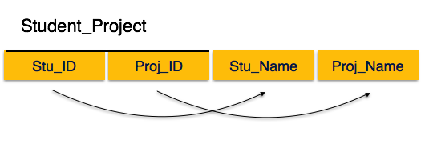
2NF
Table is in 1NF (First normal form)
No non-prime attribute is dependent on the proper subset of any candidate key of table.

Slide 33
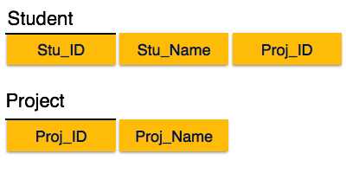
PARTIAL DEPENDENCY IS NOT ALLOWED. MUST BE FULLY FUNCTIONALLY DEPENDENT

Slide 34
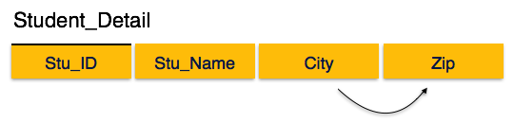
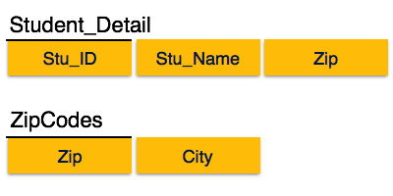
3NF
TO ELIMINATE transitive dependency

Slide 35
Boyce-Codd Normal Form
Boyce-Codd Normal Form (BCNF) is an extension of Third Normal Form on strict terms. BCNF states that −
For any non-trivial functional dependency, X → A, X must be a super-key.
In the above image, Stu_ID is the super-key in the relation Student_Detail and Zip is the super-key in the relation ZipCodes. So,
Stu_ID → Stu_Name, Zip
and
Zip → City
Which confirms that both the relations are in BCNF.

Slide 36
Query-by by-Example (QBE)
Example (QBE)
! Basic Structure
! Queries on One Relation
! Queries on Several Relations
! The Condition Box
! The Result Relation
! Ordering the Display of Tuples
! Aggregate Operations
! Modification of the Database

Slide 37
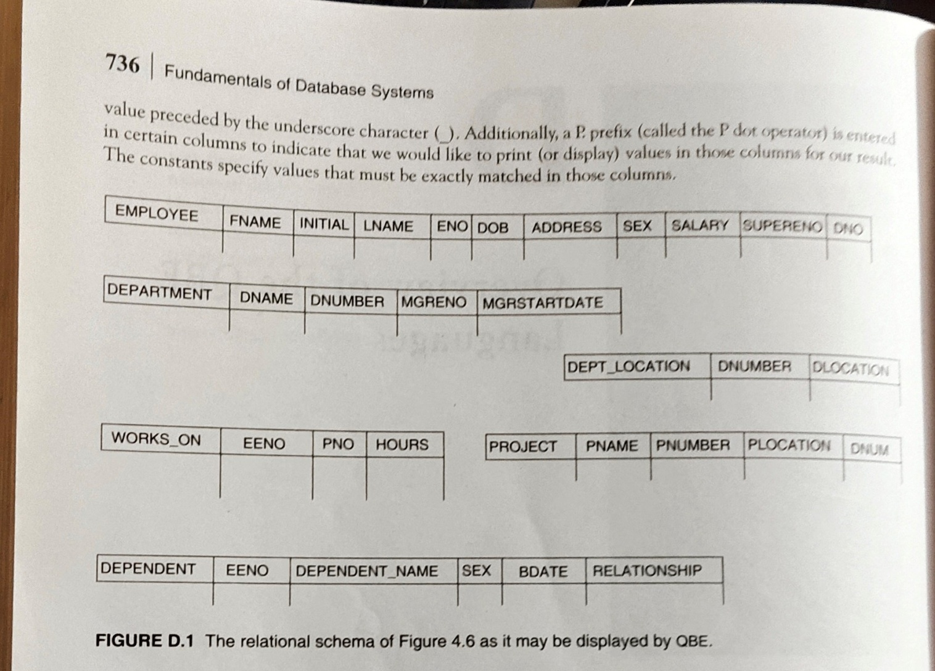
Templates

Slide 38
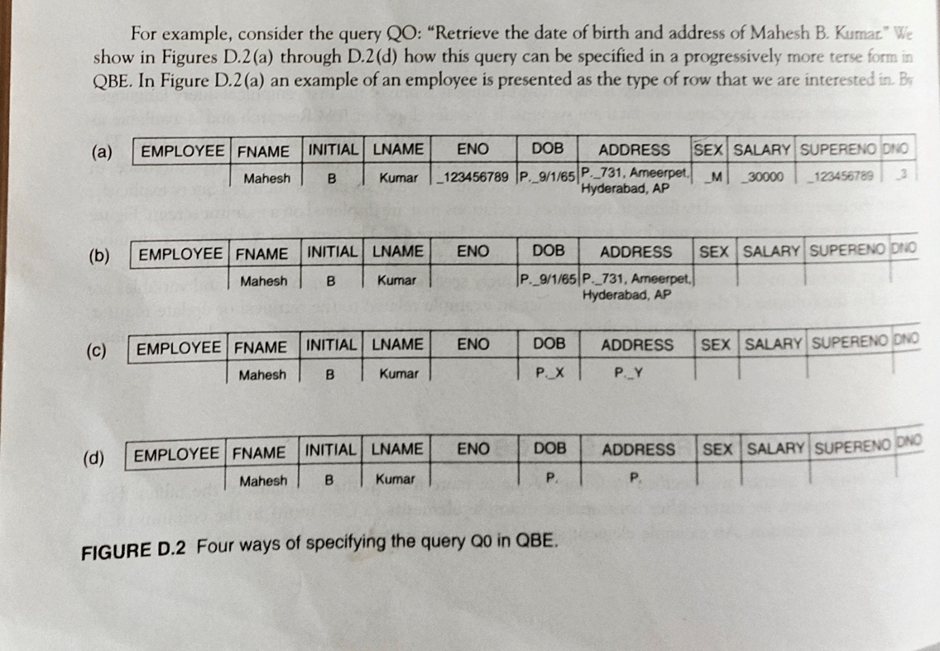
Four Ways of Specifying the Query

Slide 39
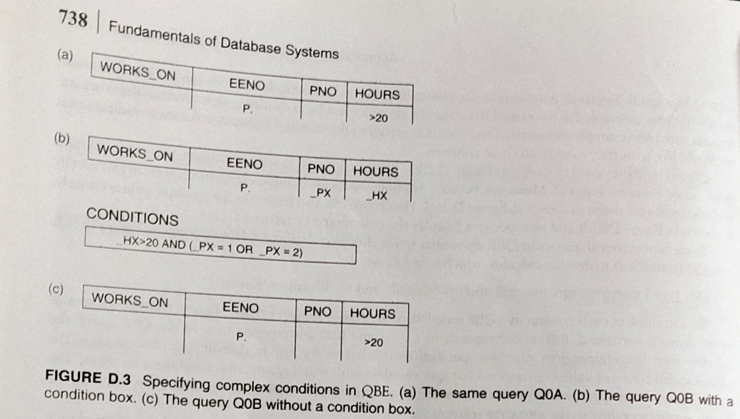
Queries
List the employee who are working more than 20 hours. (a)

Slide 40
With condition box (b)
List the employee number who work for more than 20 hours either on project 1 or 2.

Slide 41
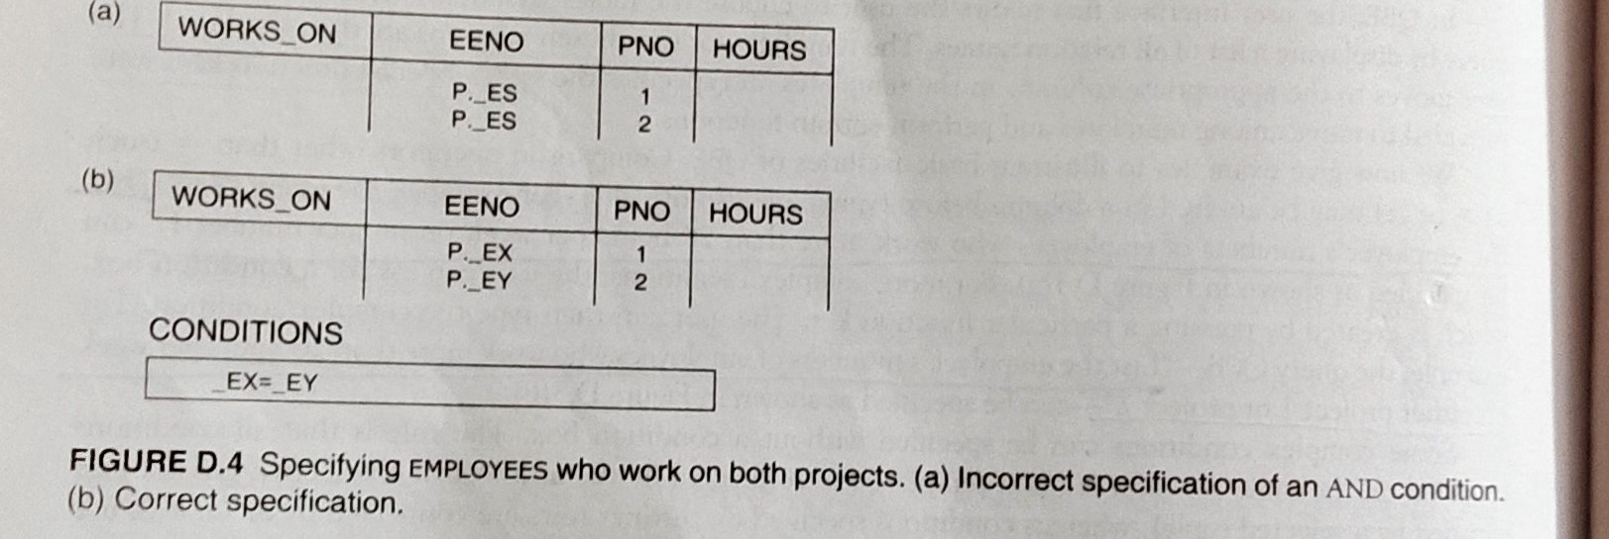
Both the projects

Slide 42
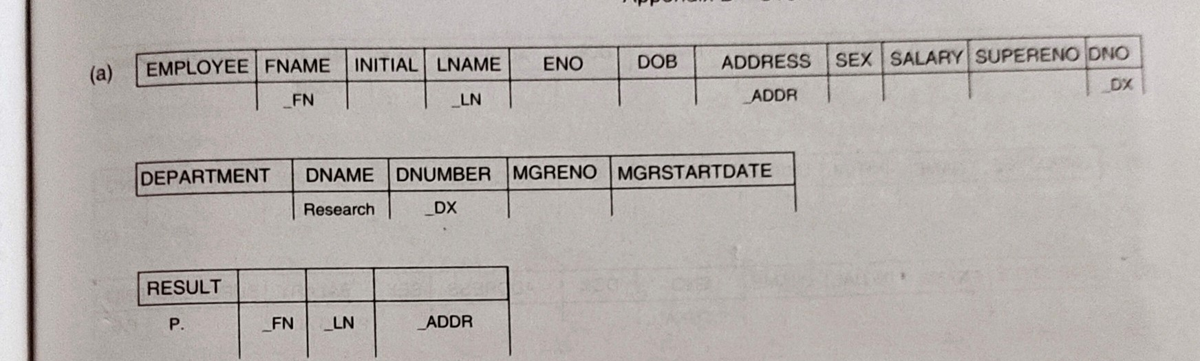
Join Operation
To list name and address who work for research dept

Slide 43
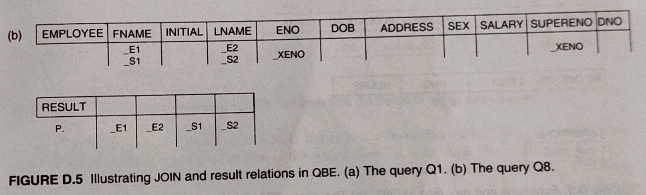
For each employee retrieve the names and their supervisor names

Slide 44
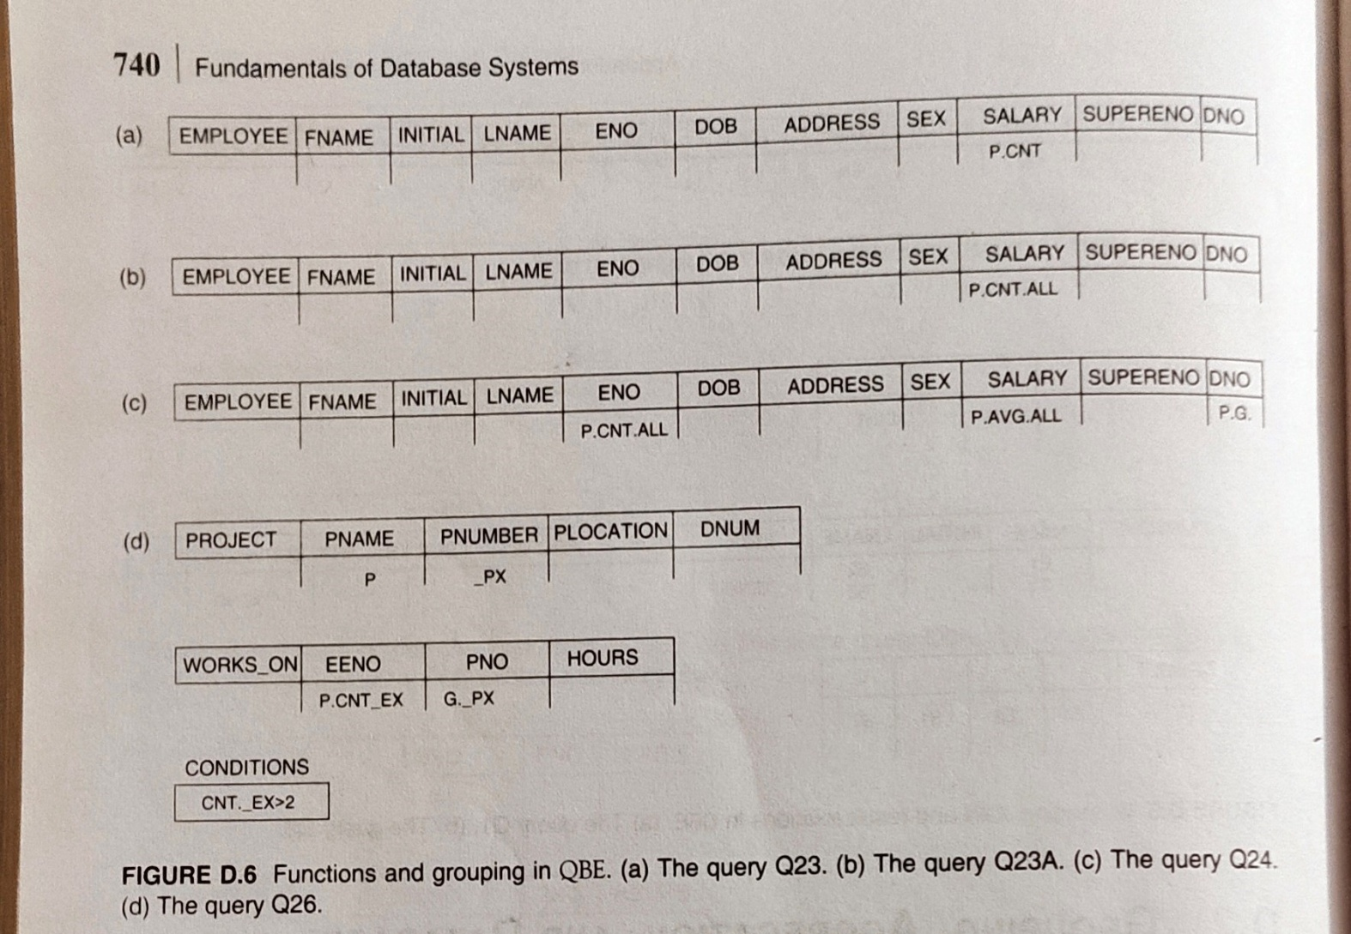
Functions and Grouping

Slide 45
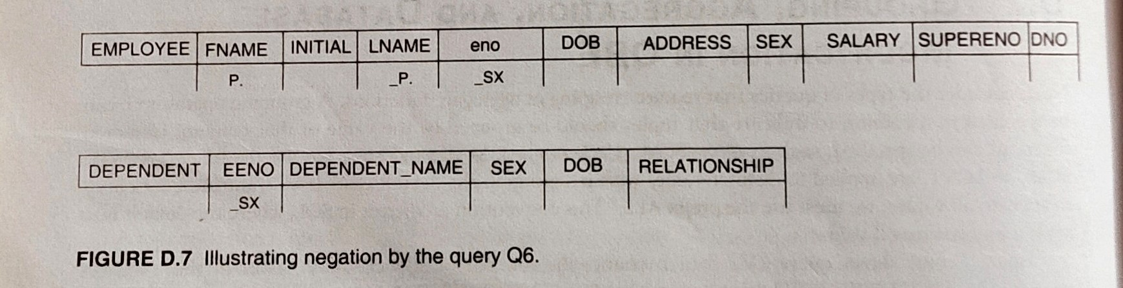
Negation
List the employees who have no dependents

Slide 46
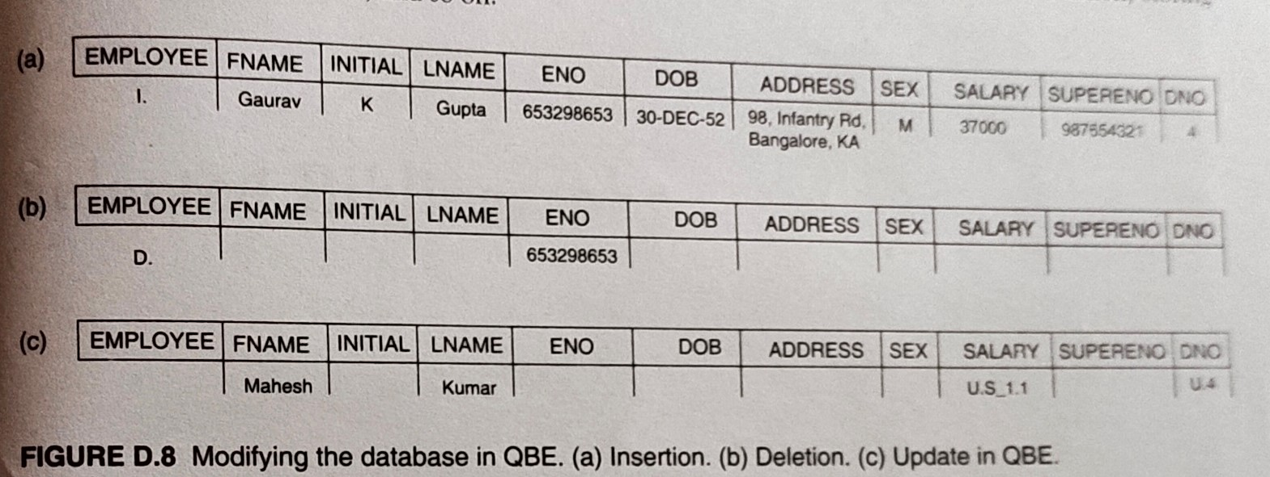
Modifying the Database

